Slide 1
Amazon Reviews For Sentiment Analysis
INFO6105 DATA SCIENCE ENGINEERING METHODS AND TOOLS
TEAM 20 SHIVPRIYA MANE
VAISHNAVI PATEL

Slide 2

Introduction
Background
Amazon, being one of the largest e-commerce platforms globally, accumulates a vast amount of customer reviews for its products, including books.
Sentiment analysis plays a crucial role in extracting valuable insights from these reviews, aiding authors, publishers, and retailers in understanding customer opinions and preferences.
This project focuses on performing sentiment analysis specifically on Amazon book reviews dataset to uncover sentiments associated with different book genres.

Slide 3
Introduction
Motivation
Customer Insights: By analyzing customer reviews, businesses can uncover both praise and concerns, directly influencing product improvements and customer service practices.
Strategic Decision Making: The insights gained from sentiment analysis are integral for strategic planning, helping to tailor products and marketing efforts to meet customer expectations more effectively.
Goals
Immediate Goals: To develop an efficient model capable of accurately classifying sentiments as positive, negative, or neutral in Amazon book reviews.
Long-Term Objectives: To leverage these insights to predict future buying behaviors and trends, and integrate this model into business analytics tools for ongoing monitoring.

Slide 4
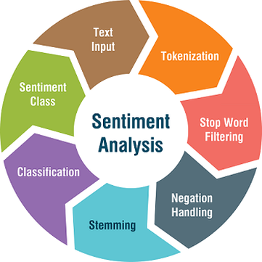
Methodology
Data Cleaning: We cleaned the dataset by removing duplicates, correcting typographical errors, and eliminating irrelevant content.
EDA: Applied techniques such as tokenization, lemmatization, and stopwords removal to prepare text data for analysis.
Feature Engineering: Utilized TF-IDF for text vectorization to reflect the importance of words in relation to the dataset.
Model Selection: Chose a combination of Logistic Regression, Random Forest and XGBoost due to their efficacy in text classification tasks.

Slide 5
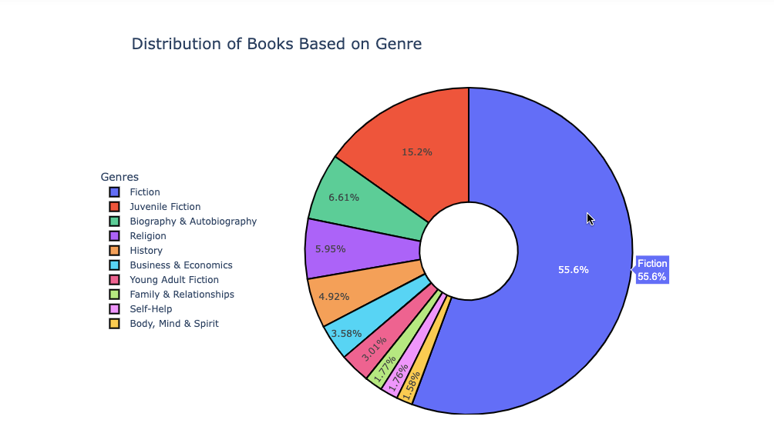
Pre Processing and EDA
Visualizing the distribution of categories in a dataset, particularly for identifying which genres or types of books are most common.

Slide 6
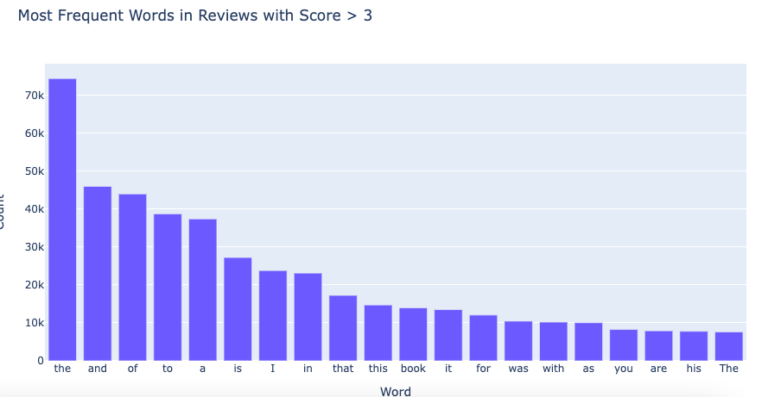
TOP 20 most commonly used words

Slide 7
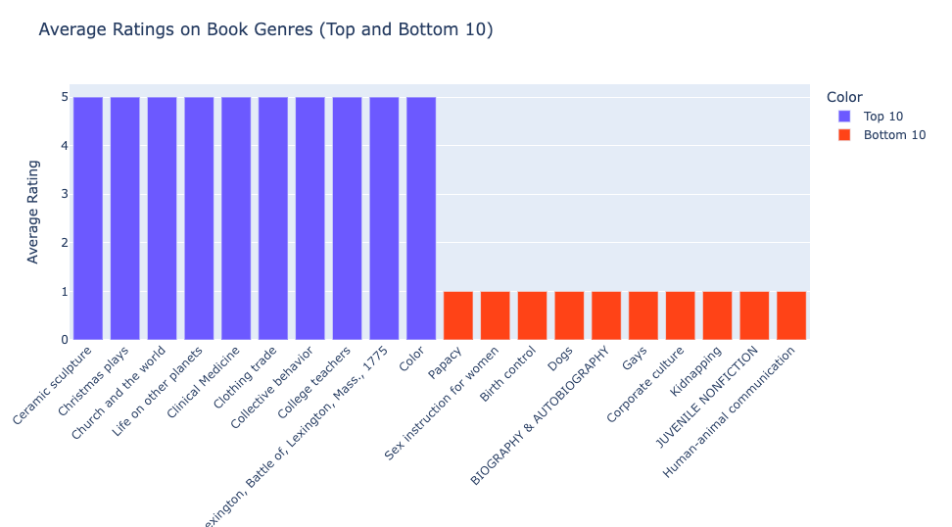
Average review scores for the top and bottom 10 book categories

Slide 8
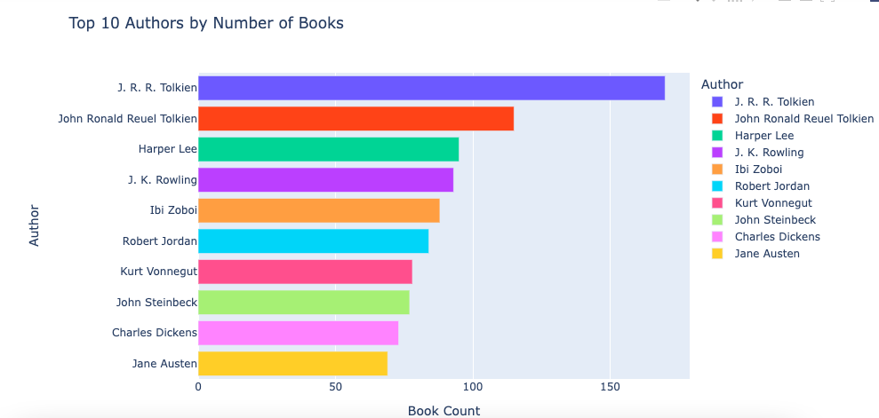
Top 10 Authors based on the reviews

Slide 9
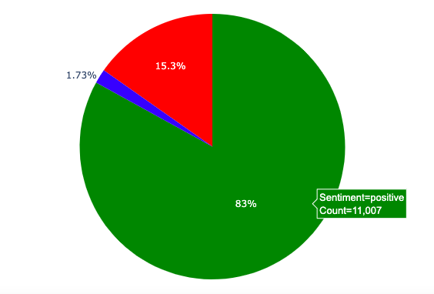
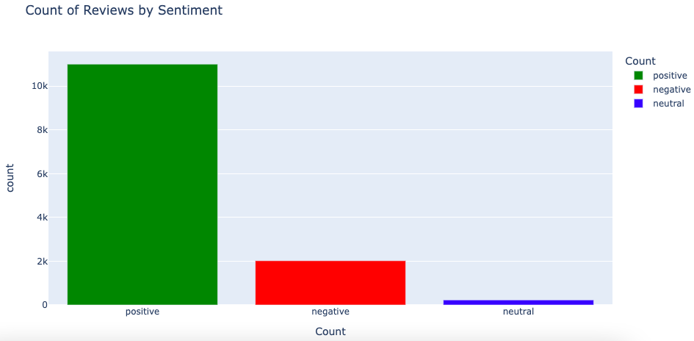
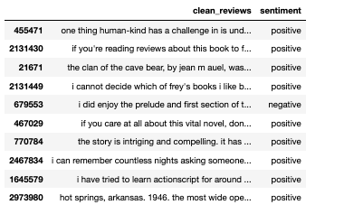
Distribution of Sentiment

Slide 10
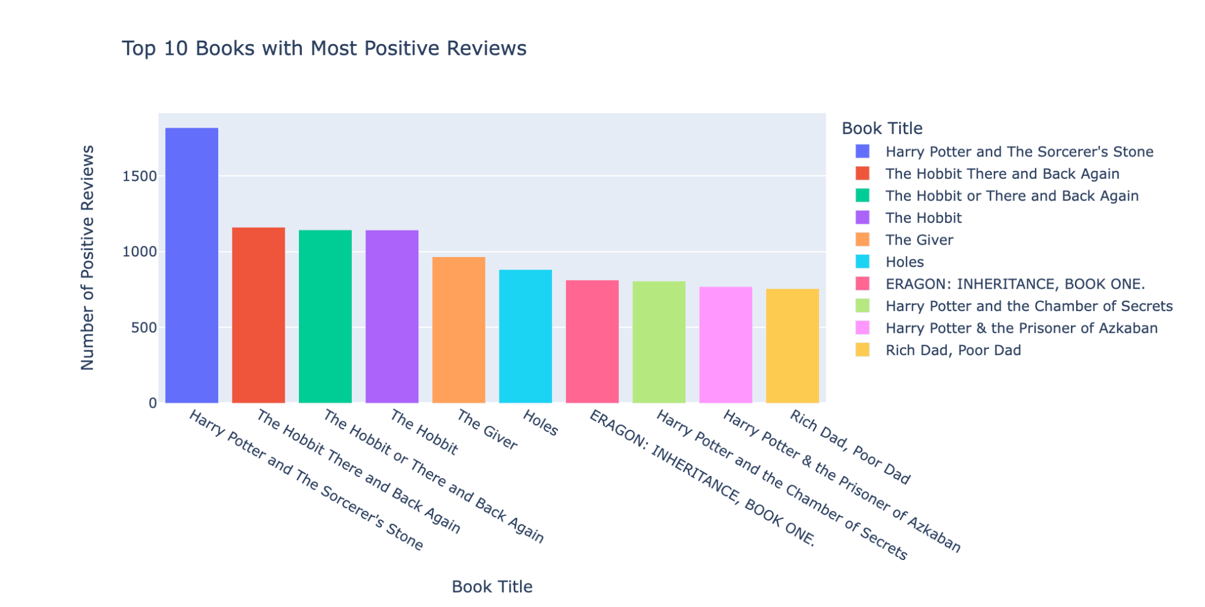
Top 10 with Positive Reviews

Slide 11
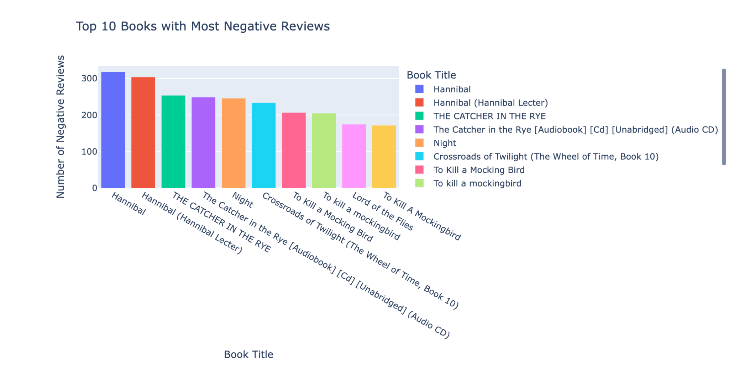
Top 10 with Neutral Reviews

Slide 12
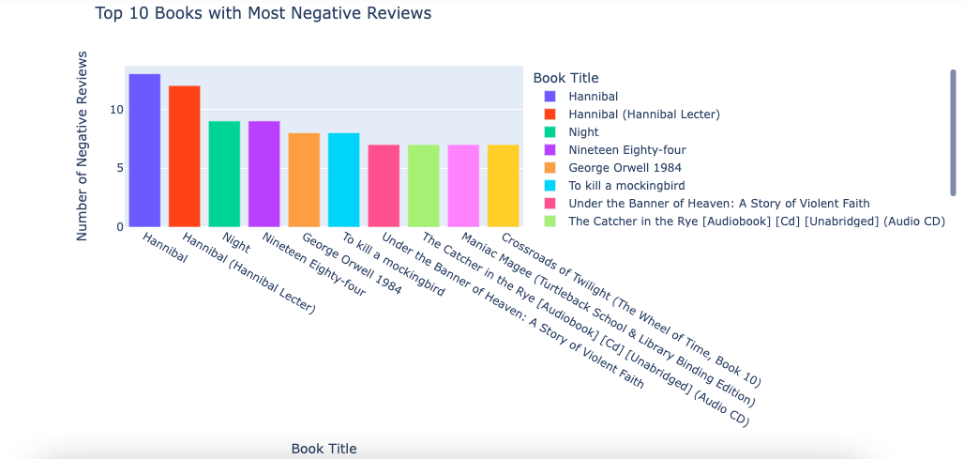
Top 10 with Negative Reviews

Slide 13
EDA Results
Sentiment Trends: Analysis revealed that positive sentiments dominate in fiction genres, while non-fiction showed a higher incidence of critical reviews.
Visualizations: Displayed through bar charts for sentiment distribution and line graphs showing sentiment trends over time.

Slide 14
Vectorization for ML Models
​Used TF-IDF vectorization for Logistic Regression,Random Forest and XGBoost because it effectively captures the importance of words in relation to the entire dataset.

Slide 15
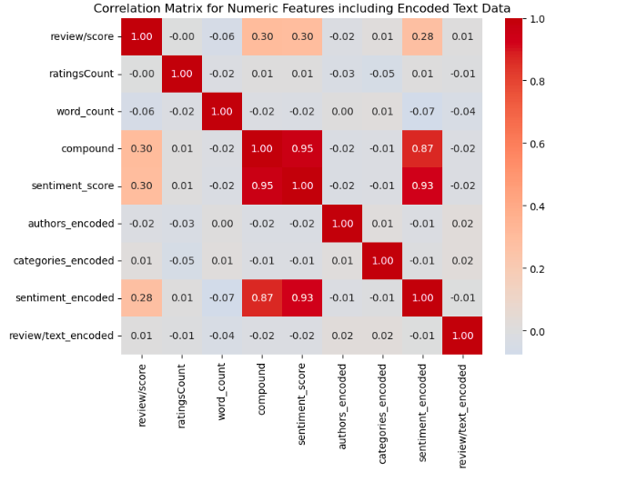
Hyperparameters : Model Validation
Heatmap Visualization - Correlation Matrix
Higher intensity red indicates stronger positive correlation, whereas blue shows negative correlation, with the diagonal representing a perfect correlation with oneself.

Slide 16
Logistic Regression
Feature Engineering and Model Selection
Efficiency: Fast and computationally efficient for large datasets.
Clarity: Offers clear interpretability of feature influence on sentiment.
Probabilistic Output: Provides likelihood scores for sentiment categories.
Flexibility: Capable of binary and multinomial classification tasks.
Baseline Comparison: Serves as a reliable baseline for evaluating other models.

Slide 17
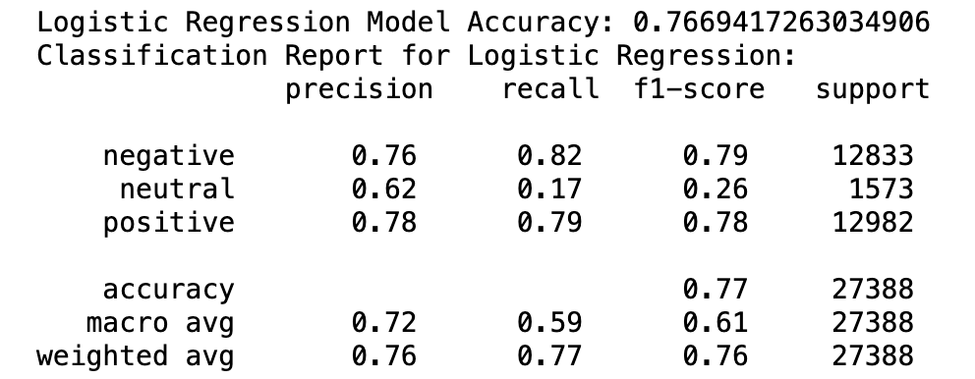
Logistic Regression Accuracy

Slide 18
Random Forest
Accuracy: Random Forests often produce a highly accurate model by combining the output of multiple decision trees to reduce overfitting.
Robustness: They are less prone to overfitting than individual decision trees and can handle outliers and non-linear data effectively.
Versatility: Capable of performing both regression and classification tasks, and they work well with both categorical and continuous data.
Feature Importance: They provide insights into the importance of each feature in the prediction, helping in feature selection and understanding the data.
Handling Missing Values: Random Forest can handle missing values in the data, either through imputation or by using the intrinsic properties of the trees.
Ease of Use: They require very little tuning of hyperparameters and can be used relatively easily without the need for scaling of data.

Slide 19
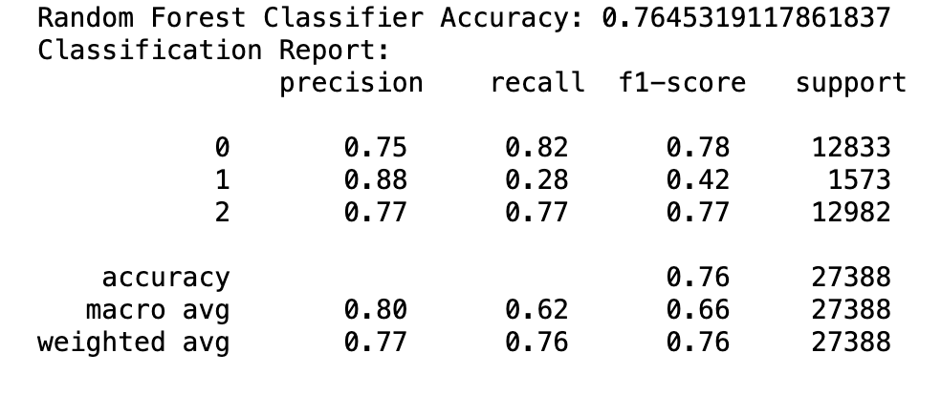
Random Forest Accuracy

Slide 20
XGBoost
High Performance: XGBoost is known for delivering excellent accuracy and efficiency on large datasets.
Handling Sparse Data: It efficiently manages sparse data, which is common in text processing.
Scalability: XGBoost scales well with large volumes of data, making it suitable for extensive review datasets.
Regularization Features: It includes built-in L1 and L2 regularization to help prevent overfitting.
Model Interpretability: Provides feature importance scores, aiding in understanding which words influence sentiment.
Flexibility: Supports custom optimization objectives and criteria, adaptable to specific sentiment analysis needs.
Robustness: Performs well across various data distributions, reducing the need for data preprocessing.

Slide 21
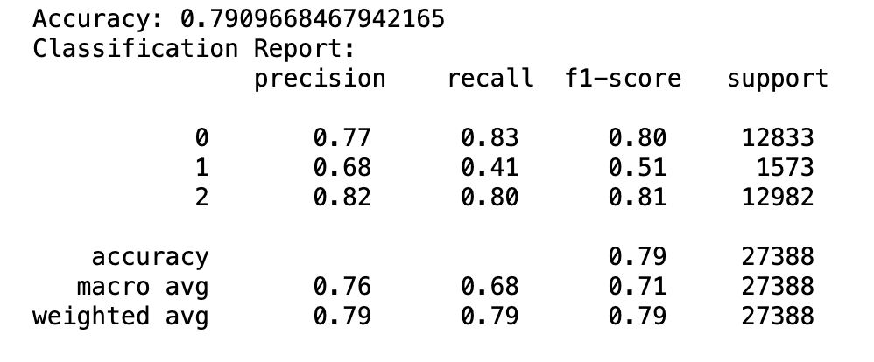
XGBoost Accuracy

Slide 22
Conclusion
Successfully able to implement various preprocessing and EDA techniques to our dataset.
Implemented various ML models and compared their performance with cross validation.
XGBoost became the cornerstone of our sentiment analysis.
Crafted a function to pinpoint pros and cons within textual feedback, providing clear insights into customer perceptions.

Slide 23
References
Thank you!
[1] Kaggle Amazon Book Review: Link
[2] Class notes, Jupyter notebook from Professor Handan Liu
[3] Medium Article: Sentiment Analysis on Amazon Reviews using TF-IDF Approach Link

